Slide 1
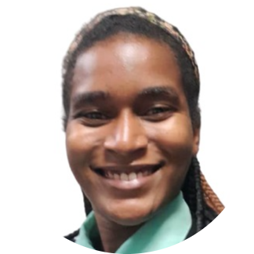
FINANCIAL INDEPENDENCE OF WOMEN
Introduction
01
02
Methodology
03
Analysis
Gothie Ridgina PASTEUR
Student at Ayiti Analytics
Memorante in Public Administration at INAGHEI
04
Conclusion

Slide 2
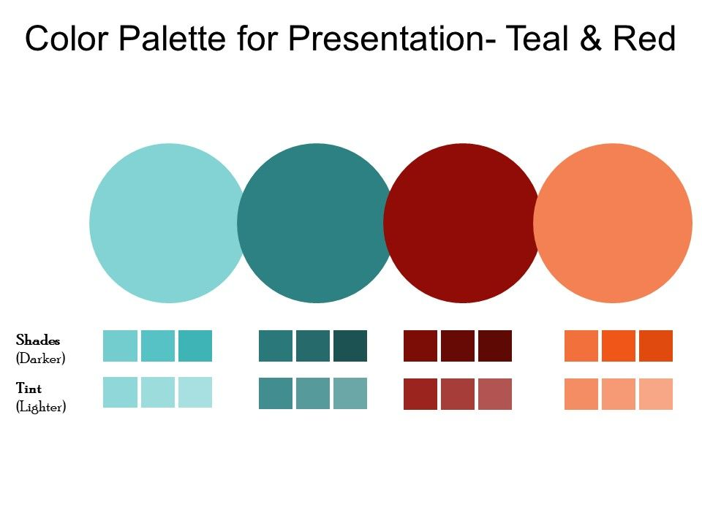
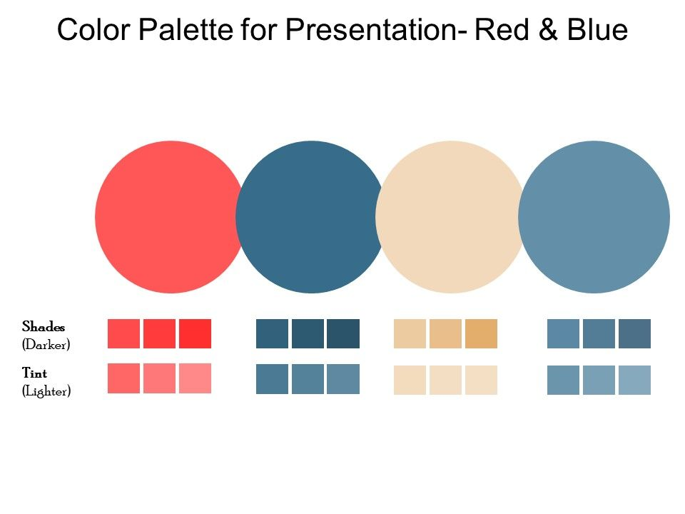
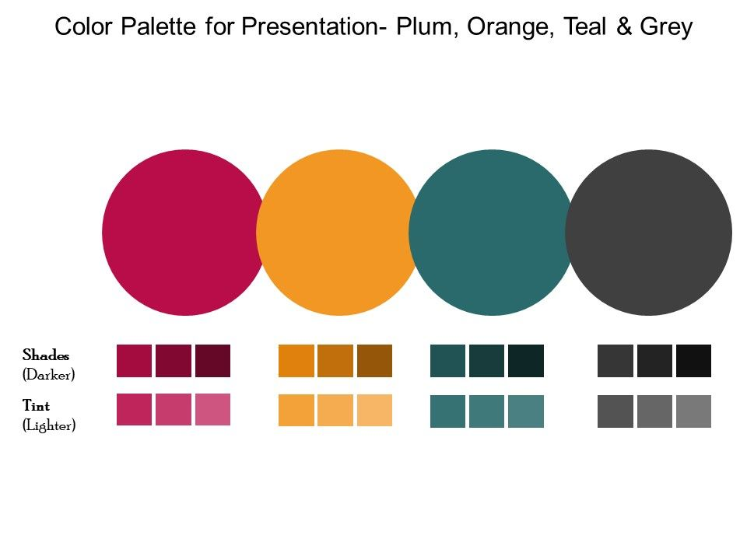
INTRODUCTION
51 %
Do you know how many of them cannot take care of their families and themselves?
1
Do you know how many of them can't live the life they want?
2
It is with all these women in financial difficulties in mind that I chose this topic. My work consists in studying the profile of independent women in order to better guide the others.
3

Slide 3
PROBLEM, AUDIENCE , DATA SOURCE
Problem
Audience
Data Source
Data are from EMMUS 2016-2017, a survey of morbidity, mortality and service utilization
The lack of financial independence of Haitian women source of lack of freedom
This work concerns women in general and all institutions that promote gender equality
To do this work, I calculated a score with tree variables.

Slide 4
METHODOLOGY
Data Cleaning
Data Analysis
Data collection
Target Variable Creation
Modelling

Slide 5
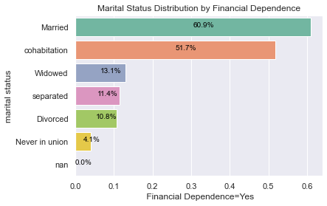
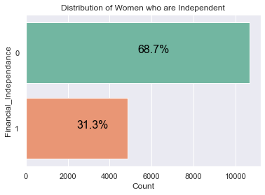
Exploratory Analysis
There are twice as many women who are financially dependent Among the 6176 married women and 1136 cohabiting women, respectively 60% and 51% are financially independent .

Slide 6
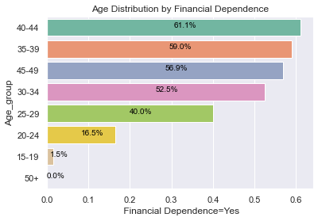
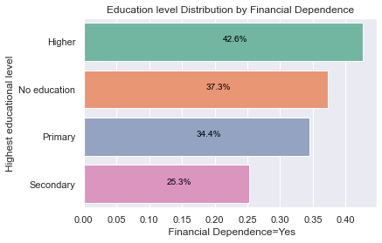
Exploratory Data Analysis
Among women aged 40-44 more than 60% are financially independent and more than 50% among those aged 30-39. 42% of highly educated women are independent.

Slide 7
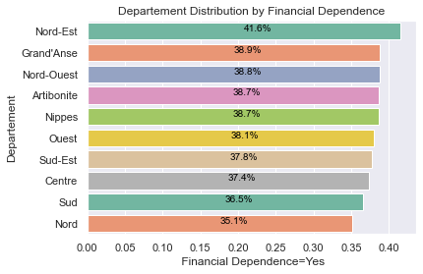
Exploratory Analysis
Among the women coming from each department directly, more than 40% of those coming from the Northeast are independent

Slide 8
Analytical Models
Technical document: https://github.com/gothie348/Final-project.git
 | Names | Accuracy | Times | AUC
0 | LogisticRegression | 0.832743 | 1.048089 | 0.90
1 | Ridge Classifier | 0.826297 | 1.500670 | 0.90
2 | AdaBoostClassifier | 0.830809 | 0.736661 | 0.90
3 | GradientBoosting | 0.831453 | 1.634922 | 0.90
4 | Random Forest | 0.804383 | 0.765919 | 0.89
5 | Decision Tree | 0.790525 | 0.021938 | 0.79
6 | KNeighbors | 0.788592 | 0.998034 | 0.86
Model Chosen
Given the performance of the models, the amount of categorical data contained in the dataset, and the objective of my work, I chose the Random forest classification model with an accuracy of and in a time of 0.76 seconds

Slide 9




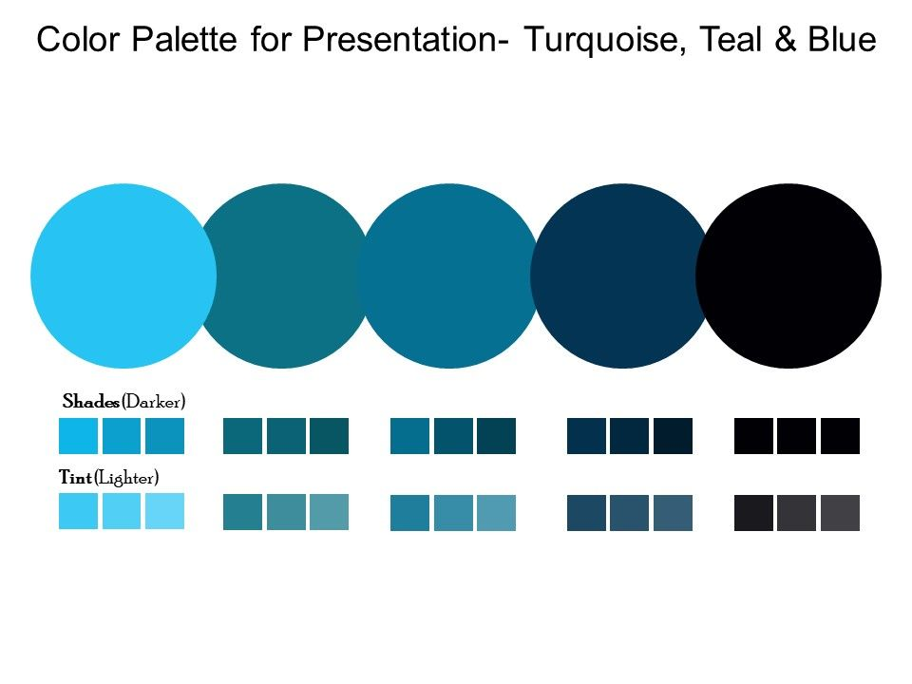
RECOMMENDATION
To sensitize the population on the importance of financial independence for them and even for the country
Implement financial policies to increase access to financial services in rural areas
The responsible institutions must take concrete actions to defend women's rights
Investing in women's education in Haiti

Slide 10

CONCLUSION
Equality in Haitian society is the business of the entire Haitian population. According to the number of observations of the dataset, more than 50% of women are financially dependent and most of them are between 19 and 29 years old, which means that it is the female youth of the country who live in these conditions.
So what are you going to do?
Sit back and watch or get involved?
The choice is yours.

Slide 11

YOU CAN CONTACT ME ON
LINKEDIN: www.linkedin.com/in/gothie-ridgina-pasteur
GITHUB: gothie348 (github.com)

